Slide 1


CMSC 471
Constraint Satisfaction Problems
Instructor: KMA Solaiman
These slides were created by Dan Klein and Pieter Abbeel at UC Berkeley. [ai.berkeley.edu]
Notes:
Please retain proper attribution, including the reference to ai.berkeley.edu. Thanks!

Slide 2


Constraint Satisfaction Problems
Standard search problems:
State is a “black box”: arbitrary data structure
Goal test can be any function over states
Successor function can also be anything
Constraint satisfaction problems (CSPs):
A special subset of search problems
State is defined by variables X_{i} with values from a domain D (sometimes D depends on i)
Goal test is a set of constraints specifying allowable combinations of values for subsets of variables
Simple example of a formal representation language
Allows useful general-purpose algorithms with more power than standard search algorithms
Notes:
Goal test has structure, it ‘s more like a manual describing a set of constraints that have to hold true

Slide 3
CSP Examples

Slide 4


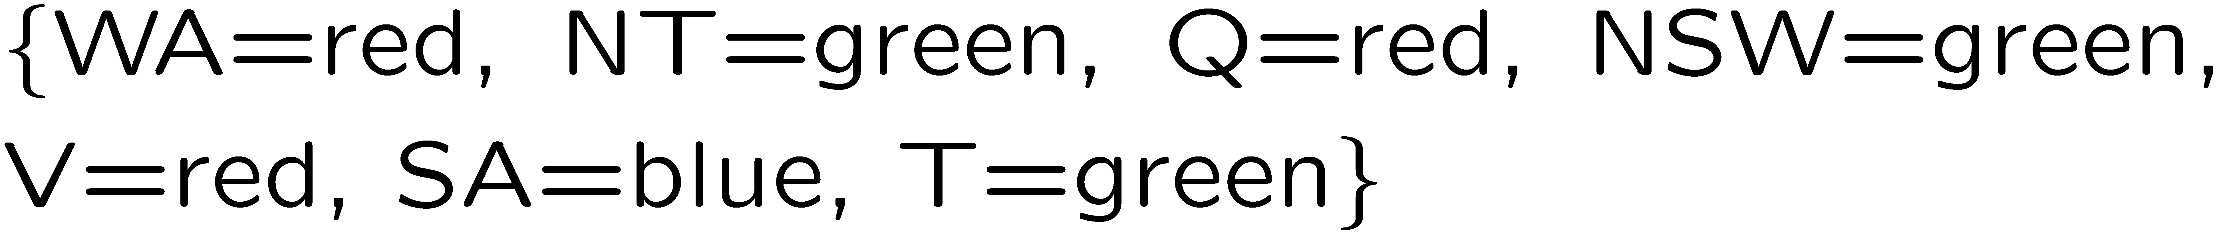
Example: Map Coloring
Variables:
Domains:
Constraints: adjacent regions must have different colors
Solutions are assignments satisfying all constraints, e.g.:
Implicit:
Explicit:

Slide 5

Solving CSPs

Slide 6
Standard Search Formulation
Standard search formulation of CSPs
States defined by the values assigned so far (partial assignments)
Initial state: the empty assignment, {}
Successor function: assign a value to an unassigned variable
Goal test: the current assignment is complete and satisfies all constraints
We’ll start with the straightforward, naïve approach, then improve it

Slide 7
Search Methods
What would BFS do?
What would DFS do?
What problems does naïve search have?
[Demo: coloring -- dfs]
Notes:
Demo:
CS188 javascript demos -> source -> exercises -> csps -> CSPs demos -> CSPs demos.html
Settings:
Graph = Simple
Algorithm = Naïve Search
Ordering = None
Filtering = None

Slide 8

Video of Demo Coloring -- DFS

Slide 9
Video of Demo Coloring -- DFS

Slide 10

Backtracking Search

Slide 11
Backtracking Search
Backtracking search is the basic uninformed algorithm for solving CSPs
Idea 1: One variable at a time
Variable assignments are commutative, so fix ordering
I.e., [WA = red then NT = green] same as [NT = green then WA = red]
Only need to consider assignments to a single variable at each step
Idea 2: Check constraints as you go
I.e. consider only values which do not conflict previous assignments
Might have to do some computation to check the constraints
“Incremental goal test”
Depth-first search with these two improvements
is called backtracking search (not the best name)
Can solve n-queens for n ≈ 25

Slide 12
Backtracking Example

Slide 13
Video of Demo Coloring – Backtracking

Slide 14
Backtracking Search
Backtracking = DFS + variable-ordering + fail-on-violation
What are the choice points?
[Demo: coloring -- backtracking]
Notes:
Demo:
CS188 javascript demos -> source -> exercises -> csps -> CSPs demos -> CSPs demos.html
Settings:
Graph = Simple
Algorithm = Backtracking
Ordering = None
Filtering = None

Slide 15

Improving Backtracking
General-purpose ideas give huge gains in speed
Ordering:
Which variable should be assigned next?
In what order should its values be tried?
Filtering: Can we detect inevitable failure early?
Structure: Can we exploit the problem structure?

Slide 16

Filtering
Keeping track of domains for unassigned variables and cross off bad options

Slide 17
Filtering: Forward Checking
Filtering: Keep track of domains for unassigned variables and cross off bad options
Forward checking: Cross off values that violate a constraint when added to the existing assignment
WA
NT
Q
SA
NSW
V
[Demo: coloring -- forward checking]
Notes:
Demo:
CS188 javascript demos -> source -> exercises -> csps -> CSPs demos -> CSPs demos.html
Settings:
Graph = Simple
Algorithm = Backtracking
Ordering = None
Filtering = Forward Checking

Slide 18
Video of Demo Coloring – Backtracking with Forward Checking

Slide 19
Filtering: Constraint Propagation
Forward checking propagates information from assigned to unassigned variables, but doesn't provide early detection for all failures:
NT and SA cannot both be blue!
Why didn’t we detect this yet?
Constraint propagation: reason from constraint to constraint
NT
Q
WA
SA
NSW
V

Slide 20

Consistency of A Single Arc
An arc X → Y is consistent iff for every x in the tail there is some y in the head which could be assigned without violating a constraint
Forward checking: Enforcing consistency of arcs pointing to each new assignment
NT
Q
WA
SA
NSW
V
Delete from the tail!

Slide 21
Arc Consistency of an Entire CSP
A simple form of propagation makes sure all arcs are consistent:
Important: If X loses a value, neighbors of X need to be rechecked!
Arc consistency detects failure earlier than forward checking
Can be run as a preprocessor or after each assignment
What’s the downside of enforcing arc consistency?
NT
Q
WA
SA
NSW
V
Remember: Delete from the tail!

Slide 22
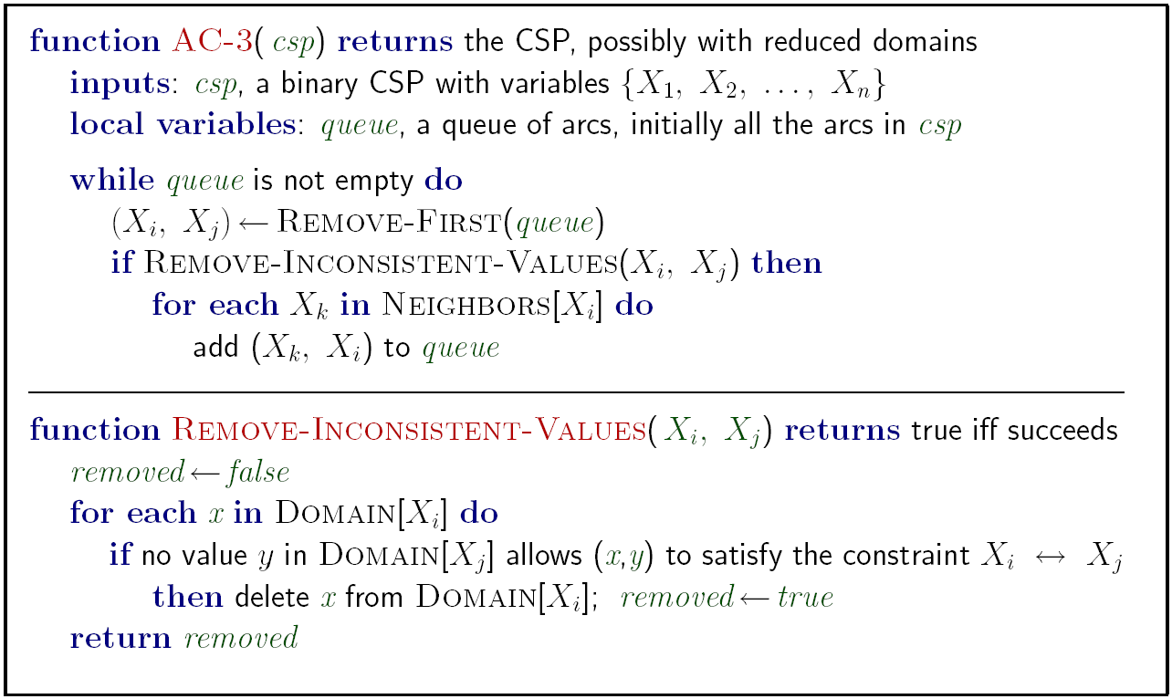
Enforcing Arc Consistency in a CSP
Runtime: O(n²d³), can be reduced to O(n²d²)
… but detecting all possible future problems is NP-hard – why?
[Demo: CSP applet (made available by aispace.org) -- n-queens]
Notes:
Auto-consistency (note initially nothing gets deleted/pruned since there are consistent options for all constraints for initial variable domains)
Flashes whenever something needs to be re-checked

Slide 23
Video of Demo Coloring – Backtracking with Forward Checking – Complex Graph

Slide 24
Video of Demo Coloring – Backtracking with Arc Consistency – Complex Graph

Slide 25
Limitations of Arc Consistency
After enforcing arc consistency:
Can have one solution left
Can have multiple solutions left
Can have no solutions left (and not know it)
Arc consistency still runs inside a backtracking search!
What went wrong here?
[Demo: coloring -- forward checking]
[Demo: coloring -- arc consistency]
Notes:
Demo:
CS188 javascript demos -> source -> exercises -> csps -> CSPs demos -> CSPs demos.html
Settings:
Graph = Complex
Algorithm = Backtracking
Ordering = None
Filtering = Forward Checking (first) / Arc Consistency (second)

Slide 26

K-Consistency

Slide 27
K-Consistency
Increasing degrees of consistency
1-Consistency (Node Consistency): Each single node’s domain has a value which meets that node’s unary constraints
2-Consistency (Arc Consistency): For each pair of nodes, any consistent assignment to one can be extended to the other
K-Consistency: For each k nodes, any consistent assignment to k-1 can be extended to the k^{th} node.
Higher k more expensive to compute
(You need to know the k=2 case: arc consistency)

Slide 28

Ordering

Slide 29

Ordering: Minimum Remaining Values
Variable Ordering: Minimum remaining values (MRV):
Choose the variable with the fewest legal left values in its domain
Why min rather than max?
Also called “most constrained variable”
“Fail-fast” ordering

Slide 30
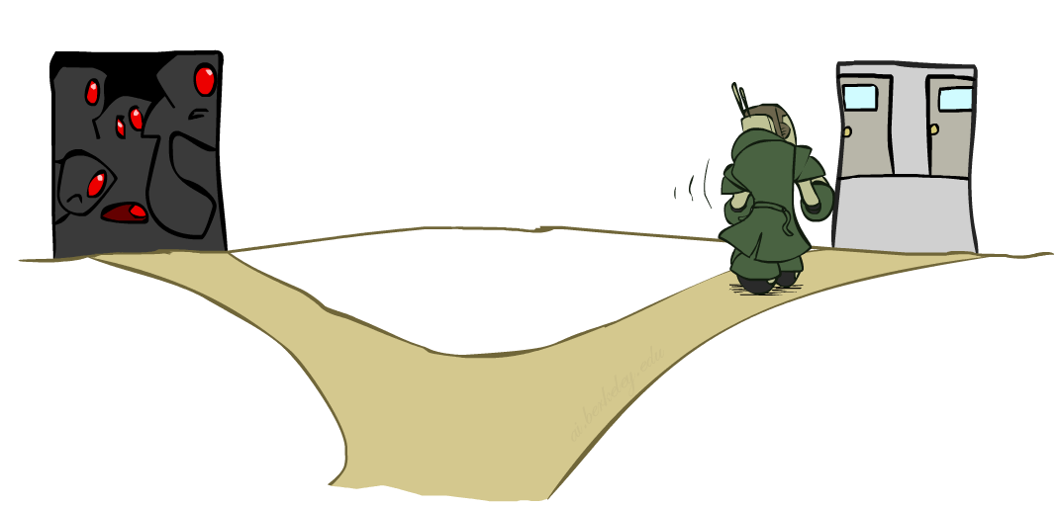
Ordering: Least Constraining Value
Value Ordering: Least Constraining Value
Given a choice of variable, choose the least constraining value
I.e., the one that rules out the fewest values in the remaining variables
Note that it may take some computation to determine this! (E.g., rerunning filtering)
Why least rather than most?
Combining these ordering ideas makes
1000 queens feasible

Slide 31
Demo: Coloring -- Backtracking + Forward Checking + Ordering
Notes:
Demo:
CS188 javascript demos -> source -> exercises -> csps -> CSPs demos -> CSPs demos.html
Settings:
Graph = Complex
Algorithm = Backtracking
Ordering = MRV
Filtering = Forward Checking
Solves already without any need for backtracking
Note: need a bigger problem to illustrate relevance of backtracking+AC+MRV+MCV

